Slide 1
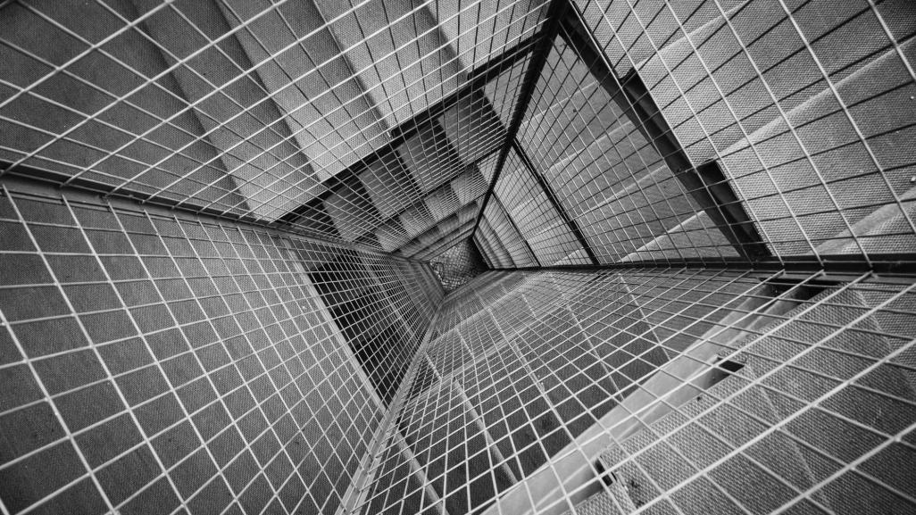
VIT BUS SERVICES
DSA PROJECT

Slide 2
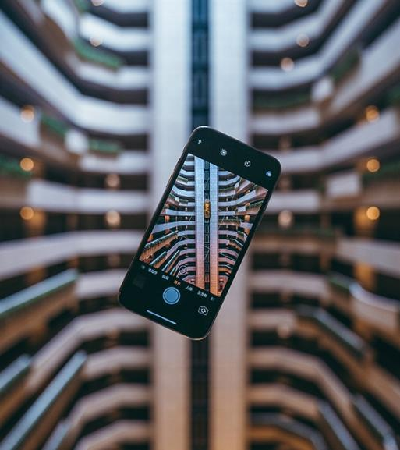
Project DEFINITION
Basic idea behind the project

Slide 3

PROJECT MOTIVATION
ABSTRACT
VIT Vellore has a huge campus with many academic blocks and hostels. Students must rush from building to building for classes within 5-10 min. This was solved by having shuttle bus services connecting all buildings and hostels of the campus. The one major problem that this brought up was the bus payment method. , it charges 15 rupees per ride. Most of the time, either the driver or the student doesn’t have change and it takes up a lot time for the money exchange. Sometimes, the drivers don’t accept online payments and there is network problem too. This issue is what I have tried solving in my own way.

Slide 4

Solution
?
?
?
Solved through DSA concepts
?

Slide 5
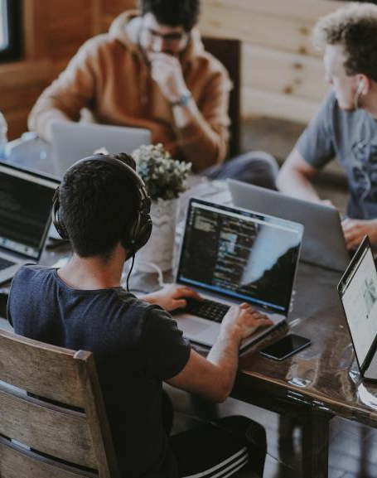
Approach to solve
Overview of the solution
Since the payment service must be used offline and we can’t add any electronics to the bus so, I came up with the idea to use the driver’s phone to scan the code from the student to make the payment process. This can be done using a QR code scanner through an app.
We will scan the code which will be the QR for the registration number of that student (similar to what we have on student ID card).
The student riding will just have to show the QR code to the driver and driver will scan the code, which will be added to the database (offline).
At the end of the day as the driver connect the phone to the internet the database will be transferred to the main server and the online bill will be generated for the students who took ride on that particular day.

Slide 6
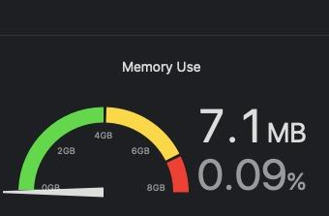
CHALLENGES
And how I overcame them
First, I sketched out my idea and start coding directly. I created functions for each process required, then I realized that this approach was increasing the time and space complexity of the program.
To better that, I chose to use circular queue as the data structure for the information storage. This used 500 nodes, which will be more than enough to handle any traffic. After all the changes the memory usage came down to what you can see on the side.
As majority of Drivers are non-tech people so I had to design a simple GUI for android with minimum user side operation and easy accessibility which will shown in the later slides.

Slide 7
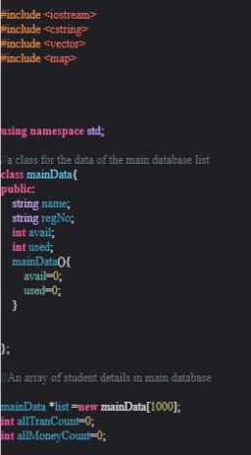
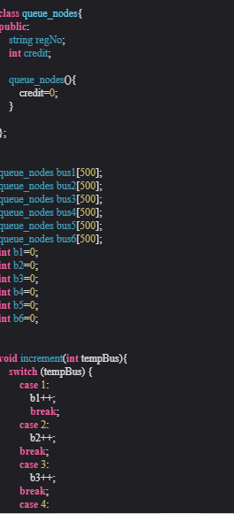
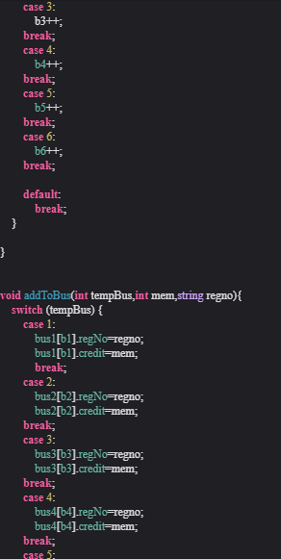
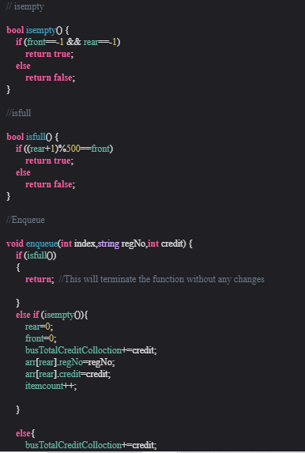
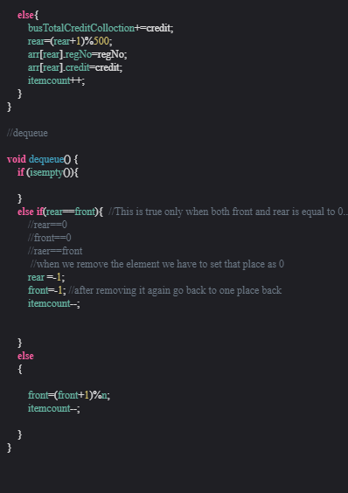
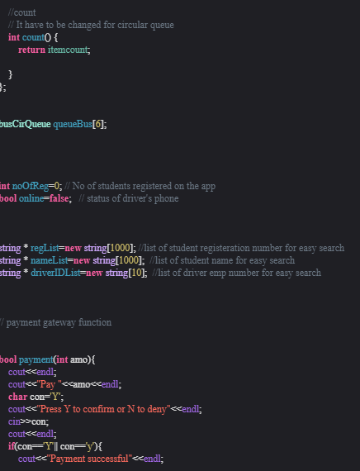
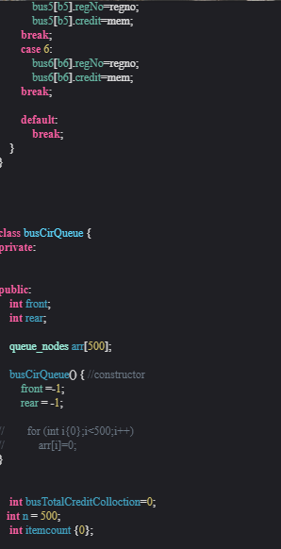
CODE

Slide 8
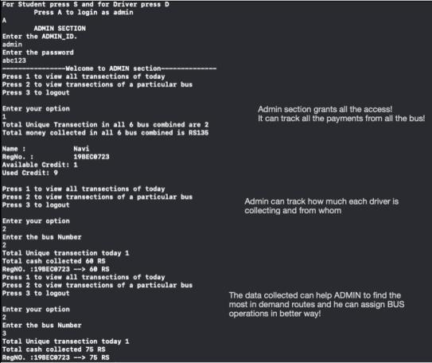
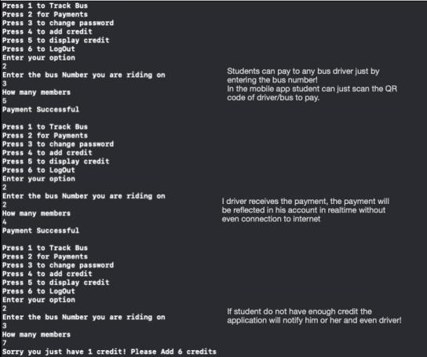
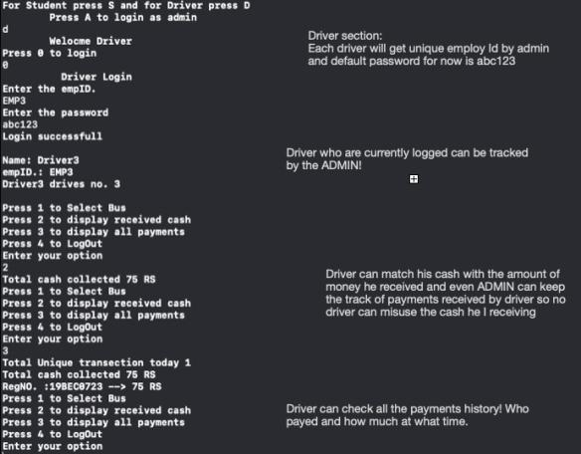
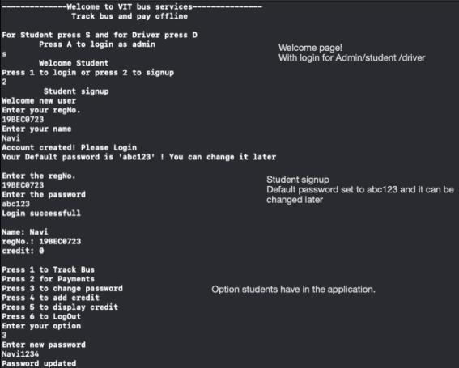
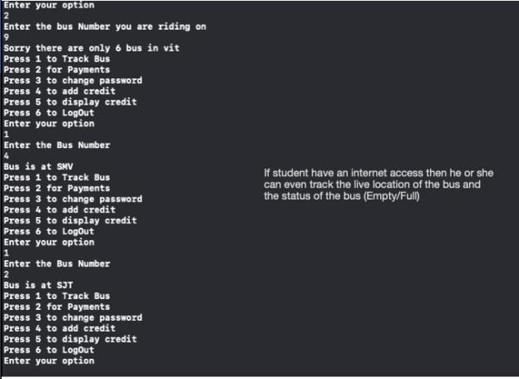
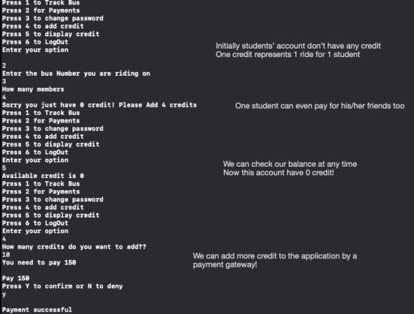
VIT BUS SERVICES CODE SAMPLE OUTPUTS

Slide 9
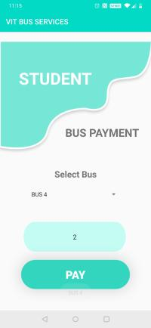
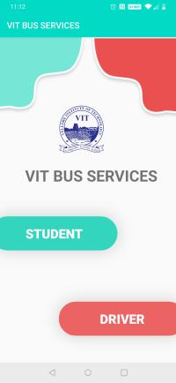
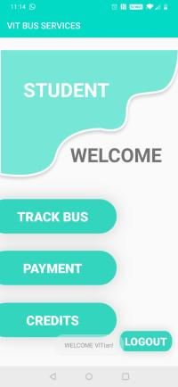
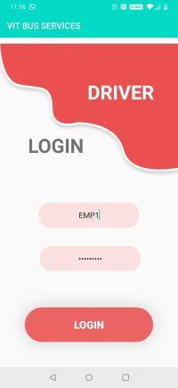
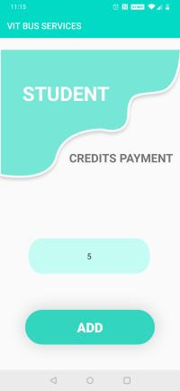
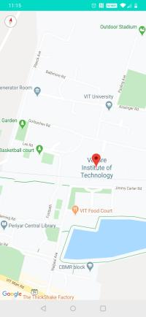
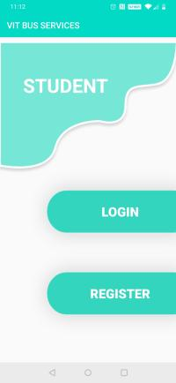
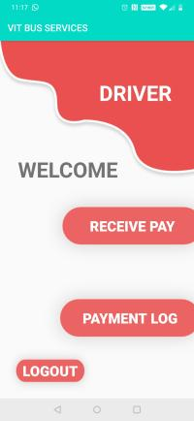
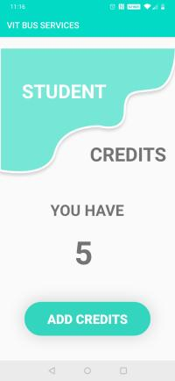
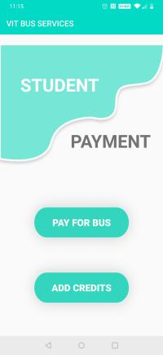
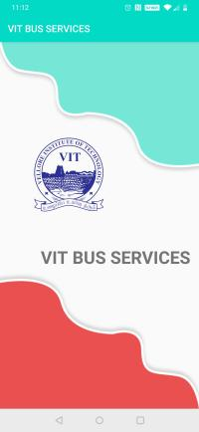
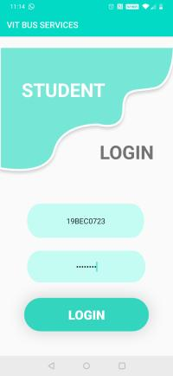
VIT BUS SERVICES APPLICATION MODEL

Slide 10


Thank you !
NAVDEEP SUREKA
19BEC0723

